Slide 1

Fudge Corporation DataWarehouse and BI Solution
IST 722 Group 4(Cd4)
Dishank Solanki – Data Engineer
Heer Thaker – BI Architect
Liyang Xue – BI Architect
Rehan Fakir – BI Analyst
Snehal Ghatpande – Project Manager, Data Architect
Yueyuan He – BI Analyst

Slide 2
Project Overview
Fudge Corporation
Fudgemart: An online retailer similar to Amazon and Walmart.
Fudgemart database consists of data about products, categories, employees, vendors, orders placed by customers, customer details and their linked credit card details.
Fudgeflix: A movie rental service similar to Netflix.
Fudgeflix database consists of data about the user accounts, their subscription plans, billing information, along with the various movies and tv shows available.

Slide 3
Project Goals
Analyze the needs of Data Warehouse
Improve the Sales Business Process for Fudge Corporation
Build an integrated data warehouse by combining data from Fudgemart and Fudgeflix
Analyze the Sales Business Process by creating a Business Intelligence Platform
Help Fudge Corporation by coming up with business recommendations driven by data for boosting their sales

Slide 4
Business Questions
How is the company performing in terms of sales: yearly, quarterly and monthly?
Which is the best performing state and worst performing state yearly in terms of number of products sold?
Which are the top performing states in terms of sold amount?
Who are the best performing suppliers yearly?
What is the contribution of each product towards yearly sales?
For Fudgemart, which category of products are in high demand?

Slide 5
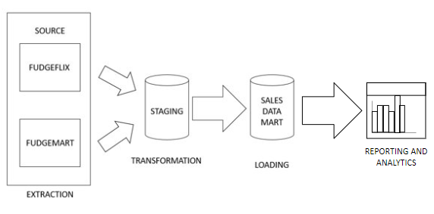
Process Followed
ETL tools used:
SSIS, SSAS
BI tools used:
Microsoft Excel, PowerBI

Slide 6
Mappings
Fudgeflix | Fudgemart | SalesDataMart
Plans | Products | DimProducts
Accounts | Customer | DimCustomers
Date_dimension | Date_dimension | DimDate
Account Billing | Orders | FactSales

Slide 7
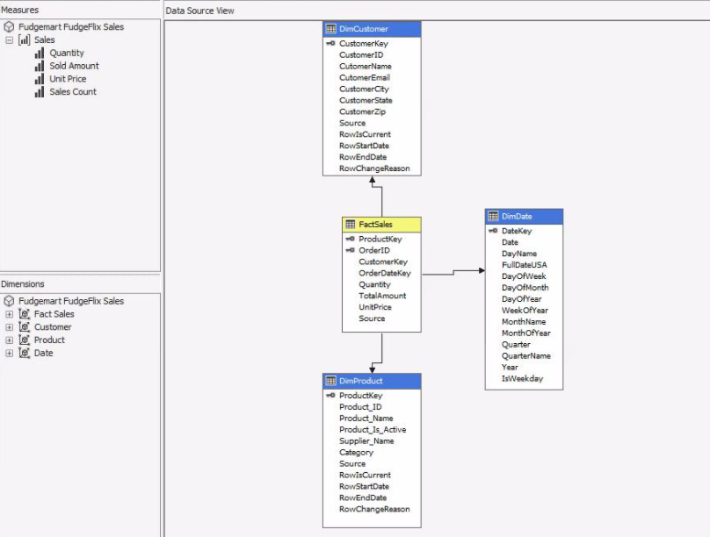
Star Schema

Slide 8
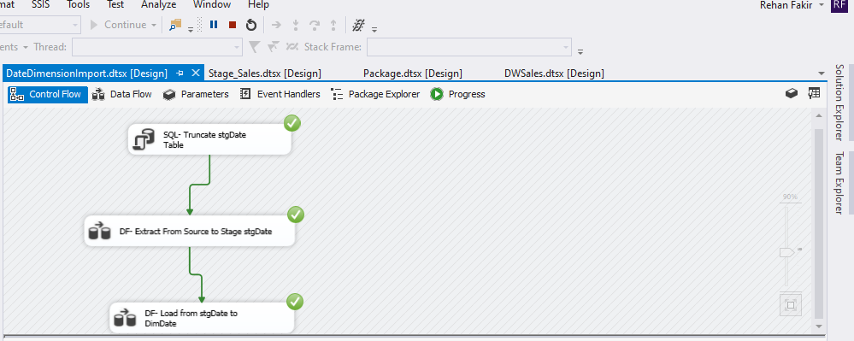
ETL Process – Source to DimDate

Slide 9
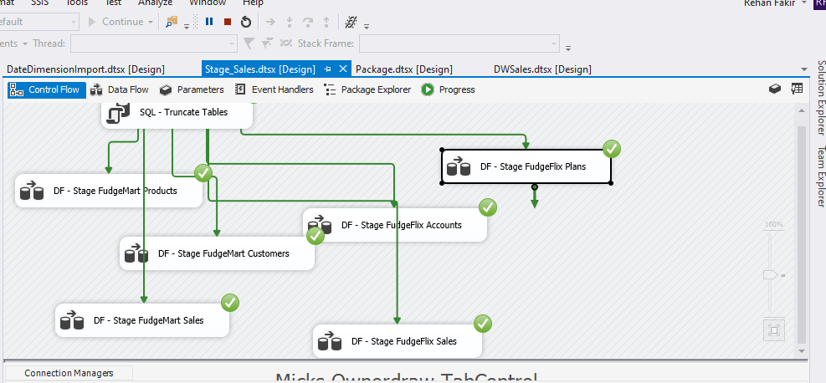
ETL Process – Source to Stage

Slide 10
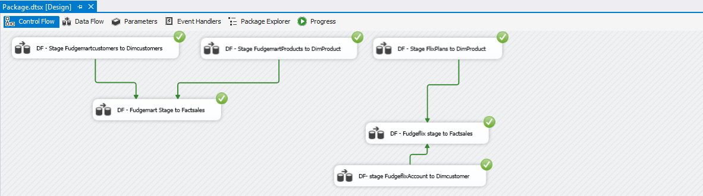
ETL Process – Stage to Data Warehouse

Slide 11
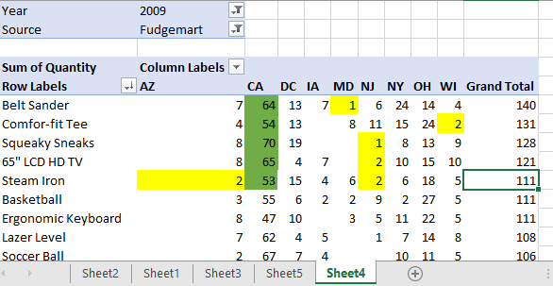
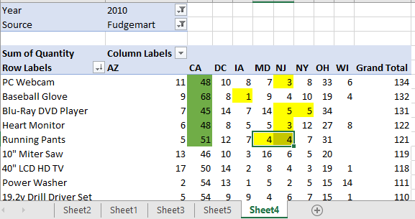
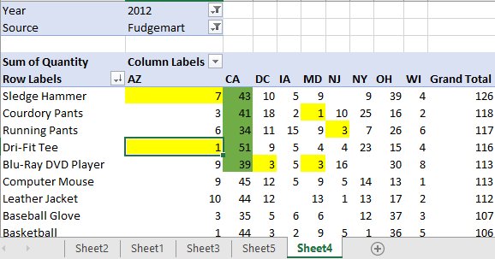
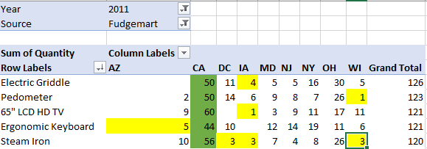
For top 5 products which are the best performing states in terms of product sold

Slide 12
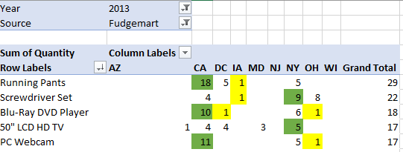
For top 5 products which are the best performing states in terms of product sold
Trends
California and New York are the best performing state
New Jersey and Maryland are the worst performing state
Operational in 8 states
LCD HD TV products are consistent

Slide 13
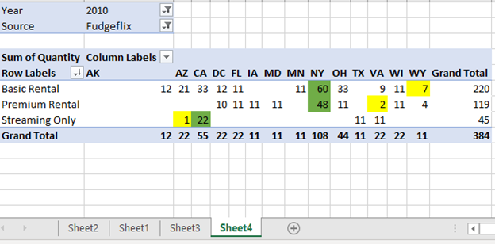
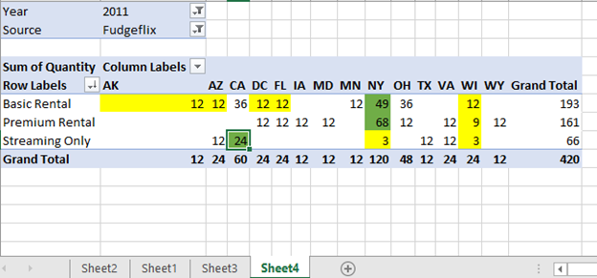
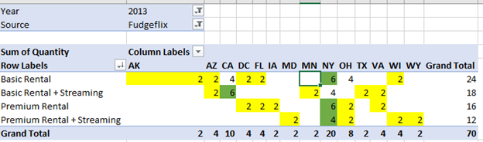
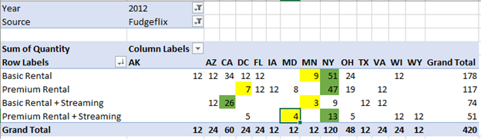
For top products which are the best performing states in terms of product sold
Trends
New York and California are the best performing state
Wyoming and Wisconsin are the worst performing state

Slide 14
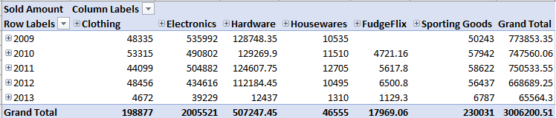
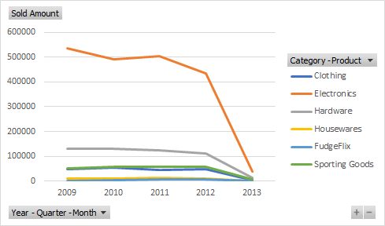
Sales Report

Slide 15
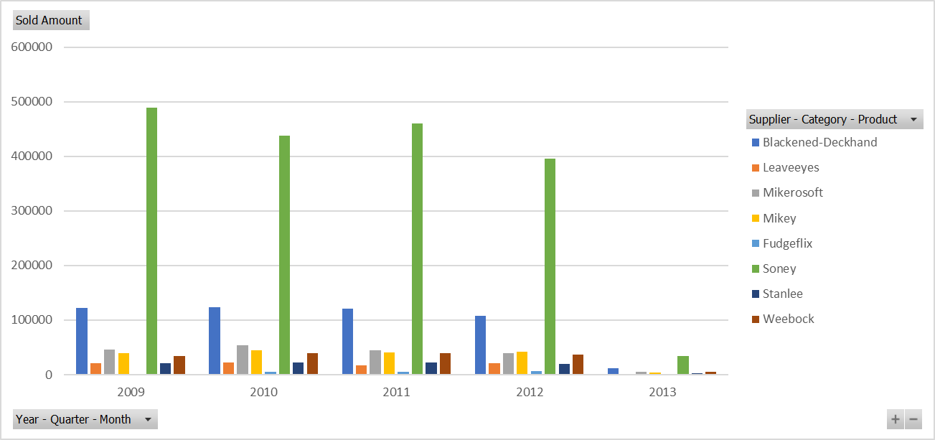
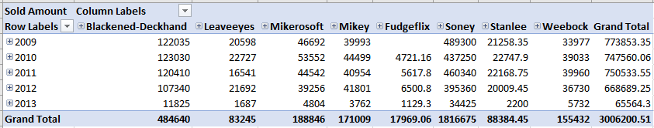
Supplier Report by Sold Amount

Slide 16
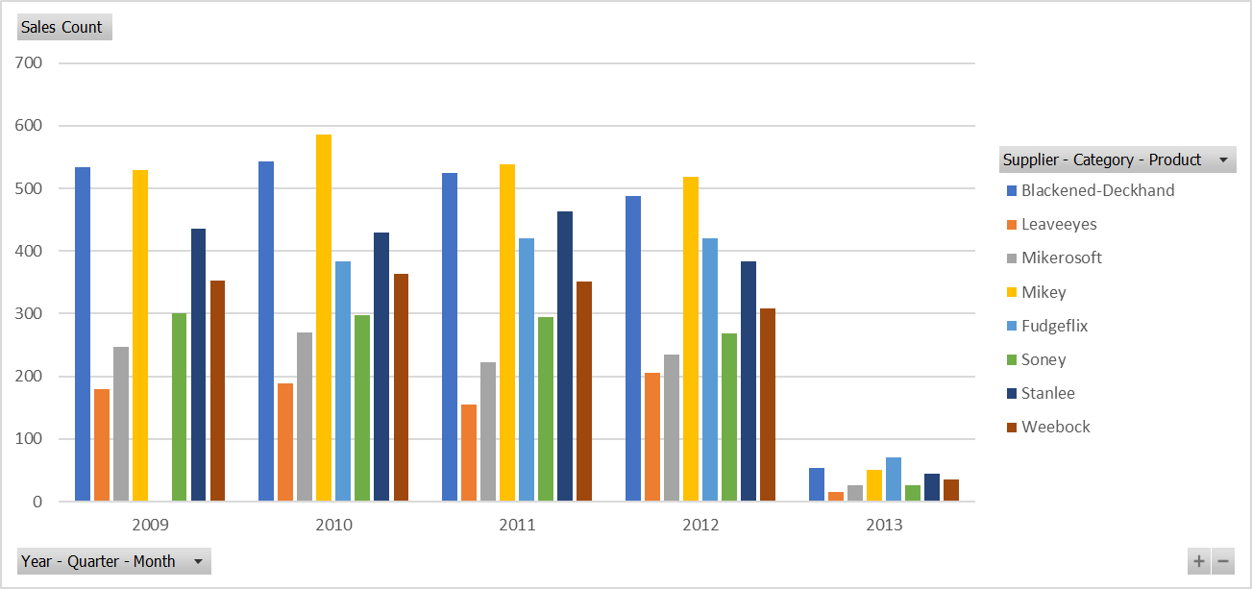
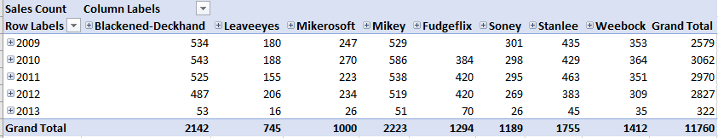
Supplier Report by Sales Count

Slide 17
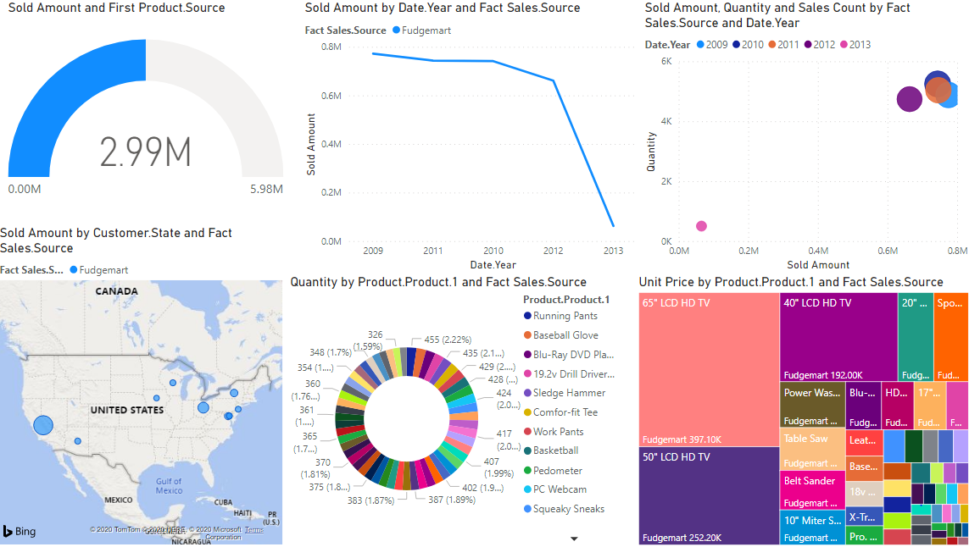
Sales Performance for Fudgemart

Slide 18
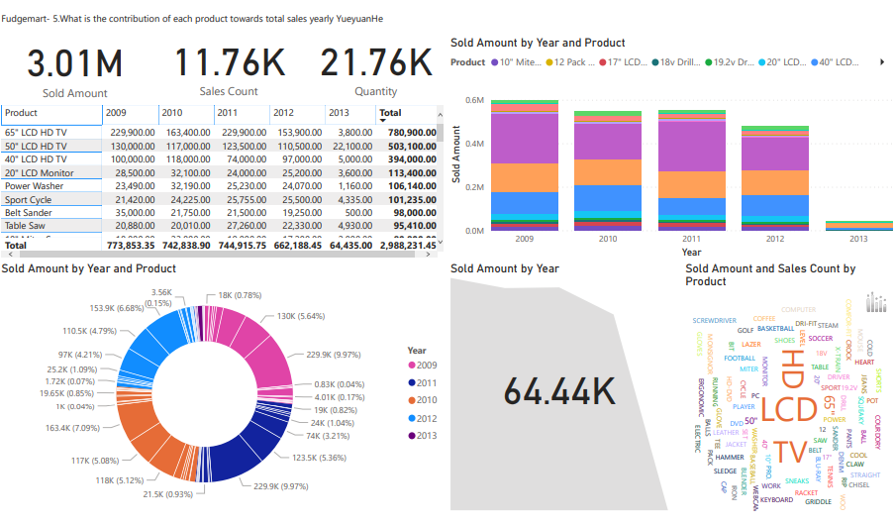
Contribution of each product towards yearly sales

Slide 19
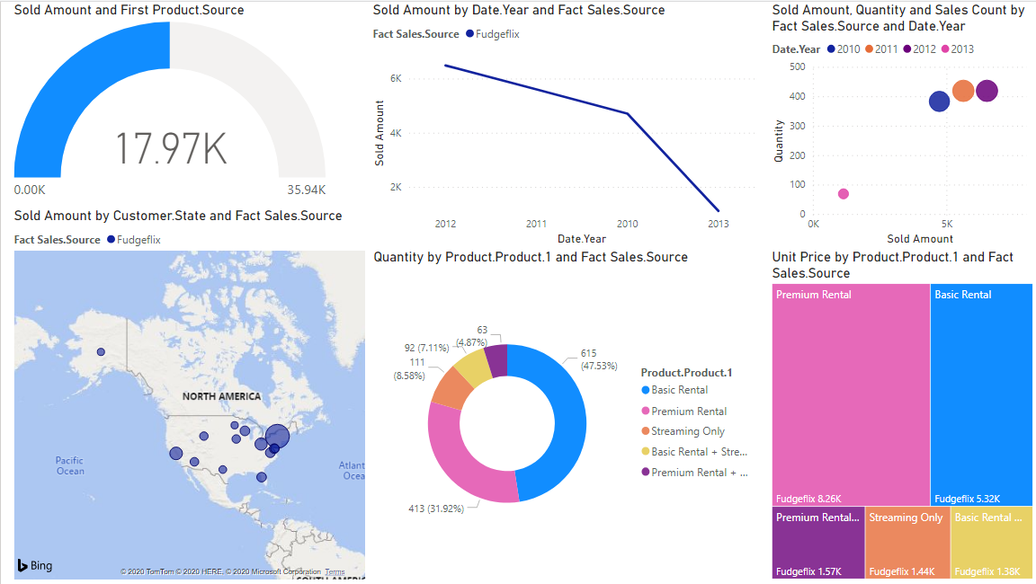
Sales Performance for Fudgeflix

Slide 20
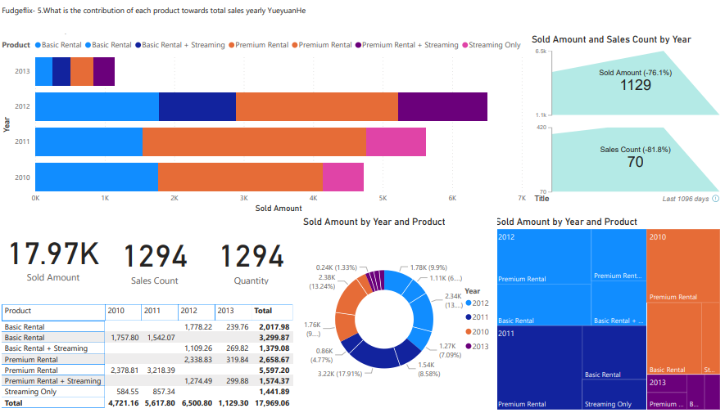
Contribution of each product towards yearly sales

Slide 21
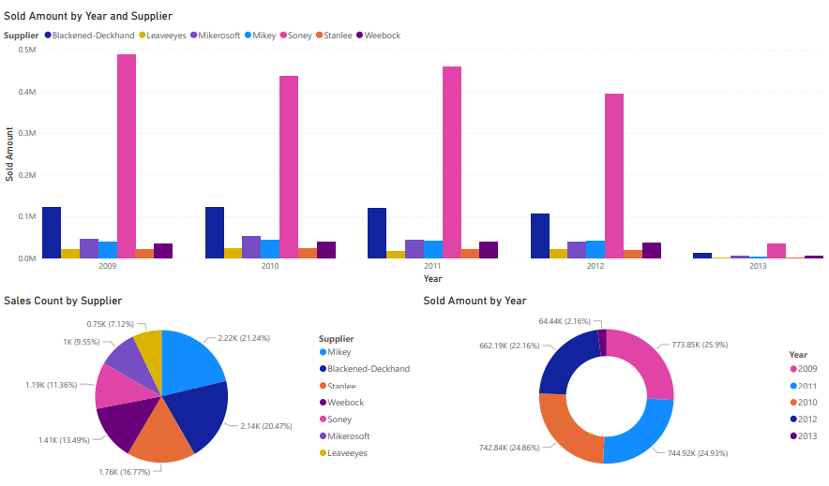
Best performing suppliers yearly

Slide 22
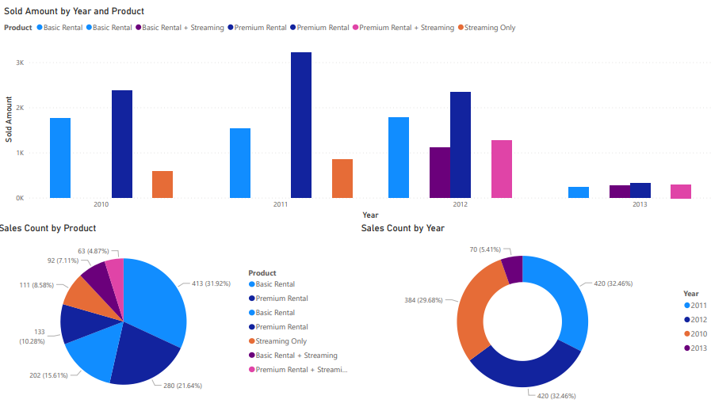
Best Performing Products in Fudgeflix yearly

Slide 23
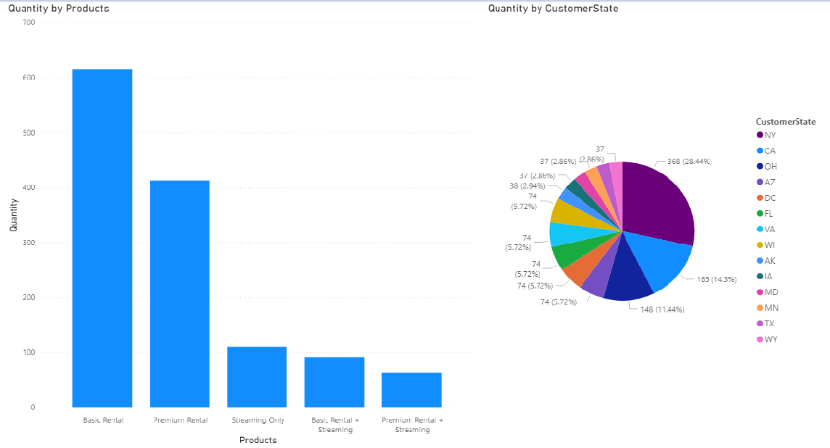
Products in high demand for Fudgeflix

Slide 24
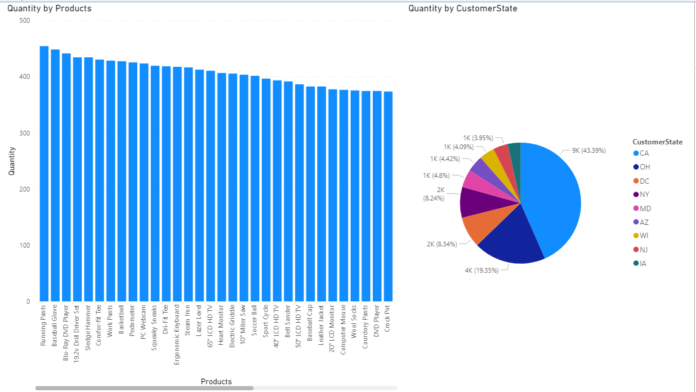
Products in high demand for Fudgemart

Slide 25
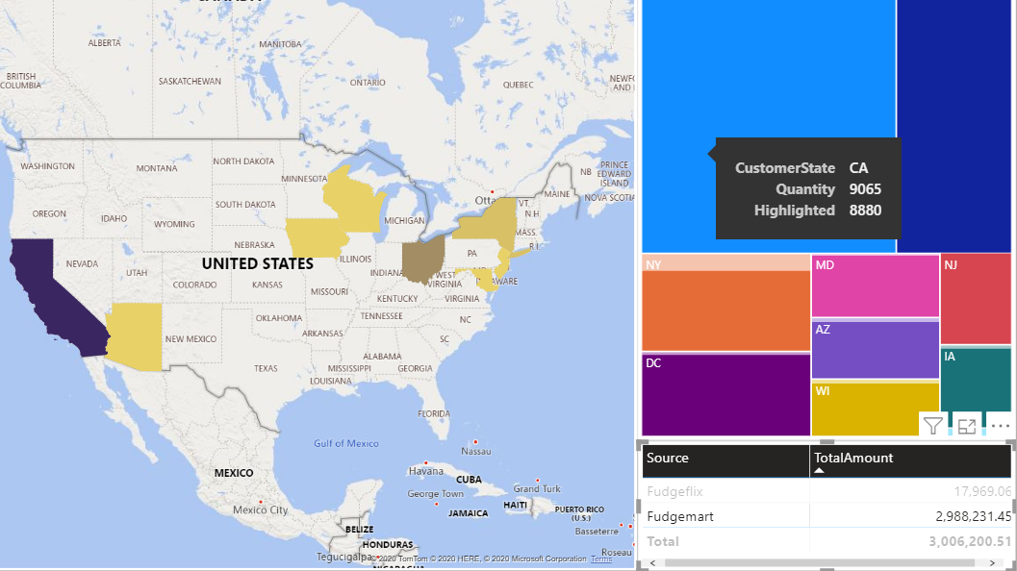
Top performing states

Slide 26
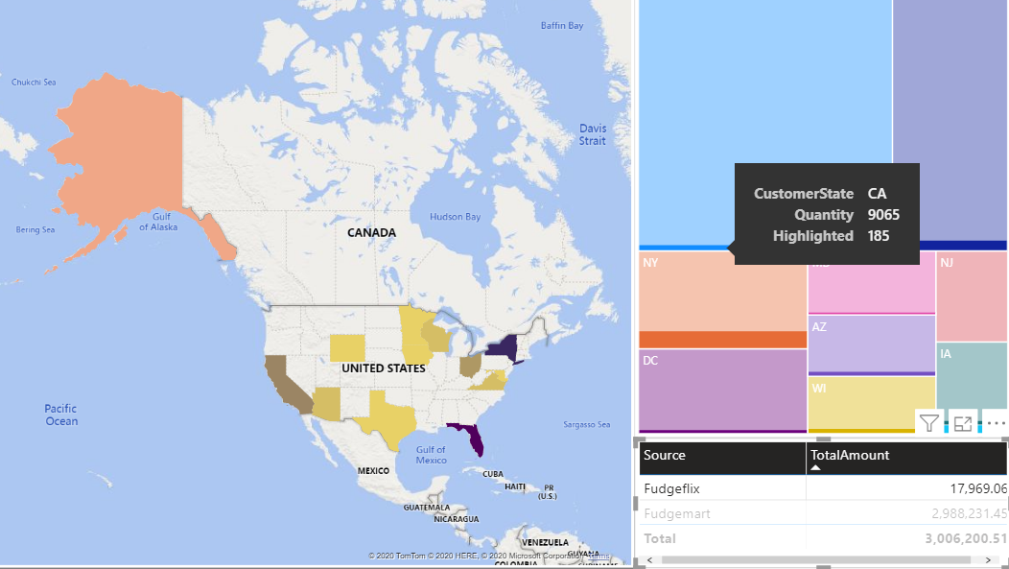
Top performing states

Slide 27
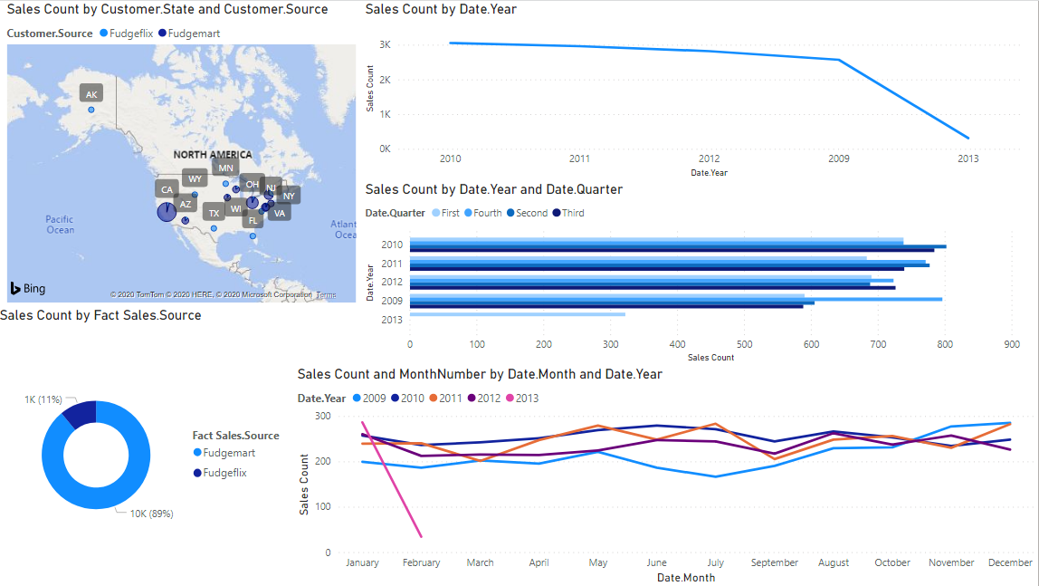
Company performance in terms of sales

Slide 28
Recommendations
Fudgeflix:
Offer customers a free trial period for bundle plans
Lower the cost of Premium Rentals and Rentals to boost sales
Fudgemart:
Extensive PR Campaigns in midwestern, south-eastern and eastern states to increase customer base
Launch the budget friendly products for the target audience
Increase the supplies from top performing vendors
Make sure that the products do not go out of stock from the inventory
Increase the sales of the products in the 2nd and 3rd quarter of year

Slide 29
THANK YOU! ANY QUESTIONS?

